Slide 1
Application Lifecycle Management (ALM)

Slide 2
ALM - Test Management Tool (TMT) Managing testing resources and activities relating to your testing work. ALM Advantages and Characteristics
Advantages | Characteristics
Helps manage releases and cycles | Test Management Tool
Mange's requirements | Product of HPE
Manage Test cases | Installed on Windows and Linex
Manage Test execution | Integrated with other HP Tools i.e. UFT, Load runner, WR, PC
Manage Test results | ALM is a Tool that can be customized - can be modified
Manage Defects | ALM is Built on Java
Manage Graphs and Reports

Slide 3
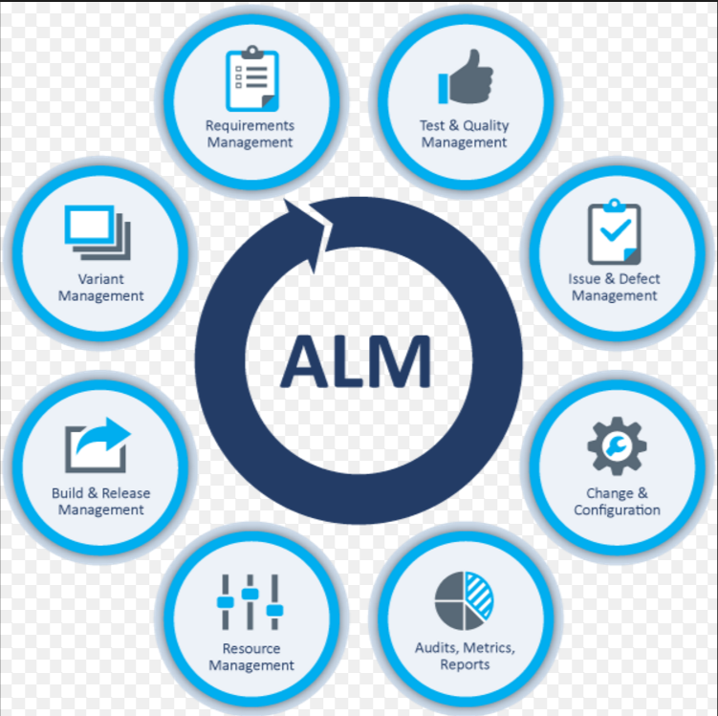
ALM Lifecycle
Defects

Slide 4
How to navigate through the defects tab
You can add user-defined fields and change the label of any of the fields in the Defects module. You can also customize project lists.
You can use the Script Editor to restrict and dynamically change the fields and values in the Defects module.
When you select a defects column with a user name value (including user-defined fields), ALM displays a list with the name and full name of each user. You can search for users, sort users, group users by user group, and select users from the users list or a group tree.

Slide 5
How to Track Defects in ALM
Create Defect | Click New Defect in the Defects grid toolbar to open the New Defect dialog box. For user interface details on the New Defect dialog box
Import Defect | In addition to creating defects directly in ALM, you can also import defects to your ALM project from Microsoft Excel. To import defects, you must first install the appropriate add-in
Link defects and other entities | You can link defects to requirements, tests, test sets, test instances, runs, run steps, business process tests, flows, and other defects.
Search for Defects | In the Defects module, you can search for defects from: The Defects grid, for example, to find defects related to a specific issue, or to modify a specific defect. The New Defect dialog box, for example, to avoid creating duplicate defects.
Assign, repair and update Defects | In the Defects module, select a defect in the Defects grid and click the Defect Details button. In the Defect Details dialog box, fill in the fields.
Analyze defects | Analyze defect data by generating reports and graphs.

Slide 6
How to search for Defects
.
This task describes how to search for defects using the Similar Defects Dialog Box/Pane. You can search for defects at any time from the Defects grid, for example, to find defects related to a specific issue, or to modify a specific defect.
When creating a new defect, you can search for similar defects, for example, to avoid creating duplicate defects.
Display the defect
Display the defect for which you want to find similar defects by doing one of the following:
Select a defect from the Defects grid.
While creating a new defect in the New Defect dialog box, enter descriptive information in the Summary and Description fields.
Start the search
Click the Find Similar Defects button.
Select Find Similar Defects to find defects similar to the current defect.
Select Find Similar Text to find defects whose summary or description is similar to a specified text string.

Slide 7
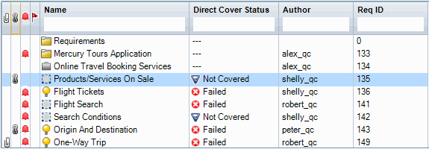
How to link defects
The following steps describe how to link defects to ALM entities (requirements, tests, test sets, test instances, runs, run steps and other defects).
Link the defect
From the module of the entity to which you want to link a defect, select the Linked Defects or Linked Entities page, and do one of the following:
Add new defect: Create the defect to which to link.
Select existing defect: Select an existing defect to which to link.
View results
You can view the linked entity from the corresponding defect, and you can view the linked defect from the corresponding entity.
In grid views, when an entity is linked to a defect, ALM adds the Linked Defects icon to the entity.

Slide 8
User Interface elements are described in the next slide:

Slide 9
UI Element (A - Z) | Description
Actual Fix Time | The actual number of days needed to fix the defect. If this field is left blank, ALM automatically calculates the Actual Fix Time as Closing Date–Detected on Date.
Assigned To | The user name of the person who is assigned to fix the defect.
Closed in Version | The application version in which the defect was closed.
Closing Date | The date on which the defect was closed.
Comments | Comments about the defect. To add a new comment, click the Add Comment button. A new section is added to the Comments box, displaying your user name and the database's current date.
Defect ID | A unique numeric ID for the defect, assigned automatically by ALM. The Defect ID is read-only.
Description | Describes the defect in detail.
Detected By | The user name of the person who submitted the defect.
Detected in Cycle | The cycle in which the defect was detected. When assigning a defect to a cycle in the Detected in Cycle field, ALM automatically assigns its release to the Detected in Release field.
Detected in Release | The release in which the defect was detected.
Detected in Version | The application version in which the defect was detected.
Detected on Date | The date on which the defect was detected. Default: The current database server date.
Detected on Environment | The environment on which the defect was detected. Environments are a combination of operating systems, browsers, and so on, on which you test the application. Note: Environments are defined using the ALM Web Client. After they are defined, you can select them when reporting a defect.
Estimated Fix Time | The estimated number of days required for fixing the defect.
Modified | The date and time when this defect was last changed.
Planned Closing Version | The version in which the defect is planned to be fixed.
Priority | The priority of the defect, ranging from low priority (level 1) to urgent priority (level 5).
Project | The name of the project where the defect occurs.
Reproducible | Whether the defect can be recreated under the same conditions by which it was detected. Default: Y
Severity | The severity of the defect, ranging from low (level 1) to urgent (level 5).
Status | The current status of the defect. Defect status can be one of the following: Closed, Fixed, New, Open, Rejected, Reopen. Default: New
Subject | The subject folder.
Summary | A brief summary of the defect.
Target Cycle | The cycle in which the defect is targeted to be fixed. When assigning a defect to a cycle in the Target Cycle field, ALM automatically assigns its release to the Target Release field.
Target Release | The release in which the defect is targeted to be closed.

Slide 10
Defect Module Icons are described below:
Element | Description
 | <green asterisk>. The applicable tab is populated.
 | Alerts. Click to view alerts for the defect. Red alert. The alert is new. Gray alert. The alert has already been read. For user interface details, see Alerts Dialog Box.
 | Attachments. Click to view attachments for the specified defect. Open an attachment by selecting it from the list. If there are more than ten attachments, click the more attachments link to view the list in the Attachments Page. For details, see Attachments Page.
 | Follow Up Flags. Click to view follow up flags for the defect. Gray flag. The follow up flag is new. Red flag. The follow up date has arrived. For user interface details, see Flag For Follow Up Dialog Box.
 | Linked Entities. Click to view linked entities for the defect in the Defect Details dialog box. For user interface details, see Linked Defects/Entities Page.

Slide 11

Thank you

